Slide 1
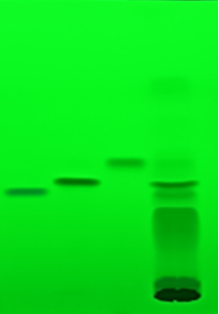
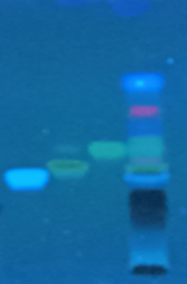
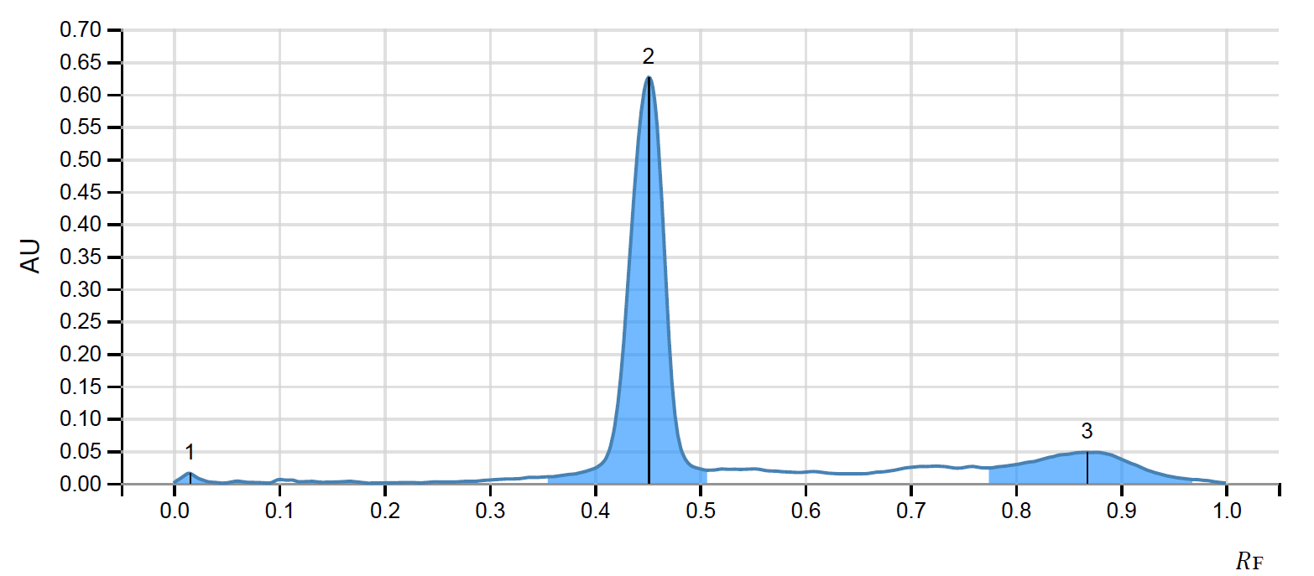
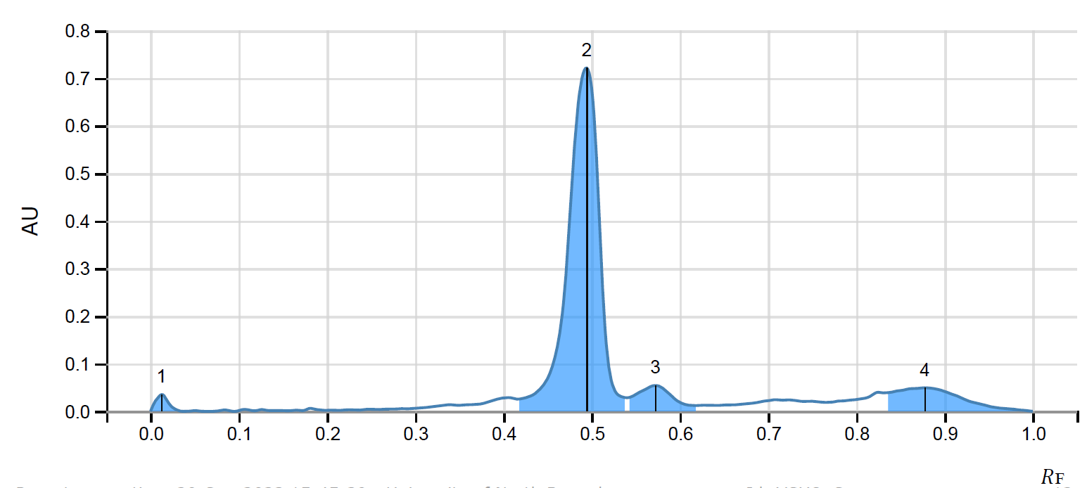
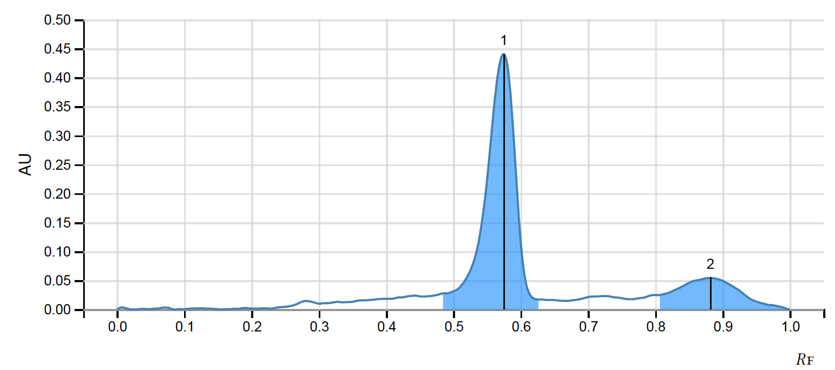
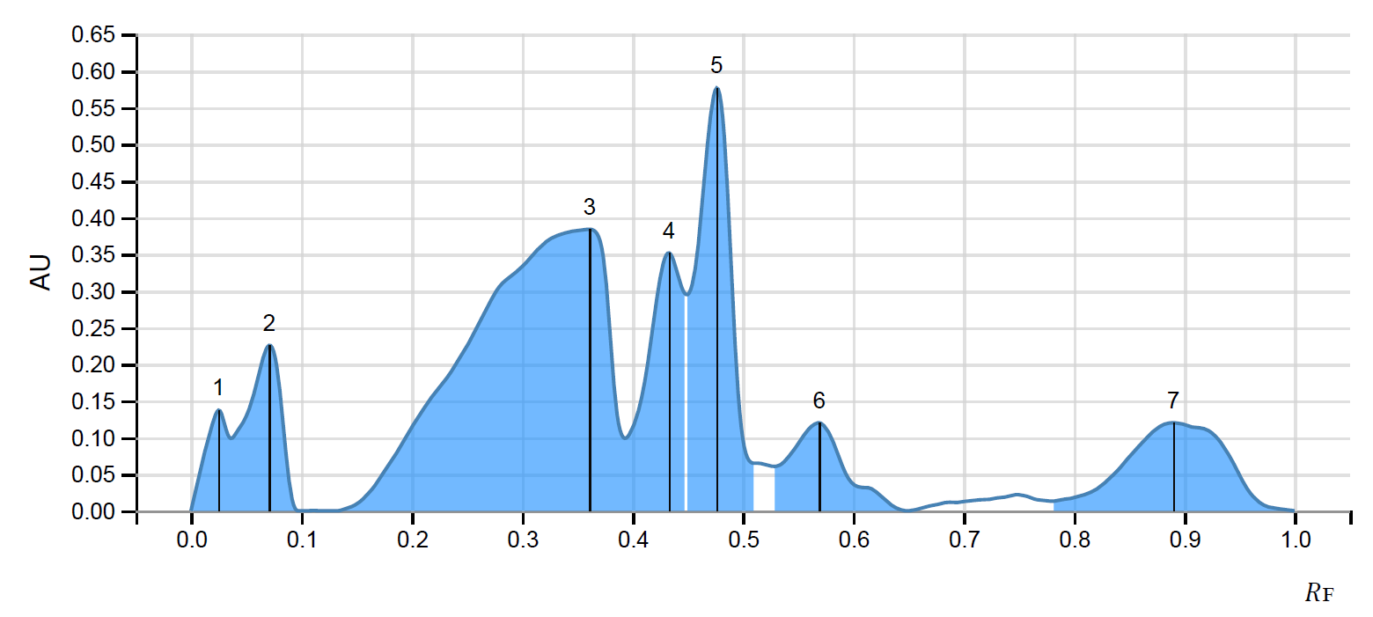
254 nm
360 nm
CA
QR
KF
FEE
CA
QR
KF
FEE
CA
QR
KF
FEE
Figure S1. HPTLC fingerprints of standards and marigold methanolic extract. Mobile phase: toluene: ethyl acetate: formic acid (13:11:2) (v/v/v); Wavelength: 254 nm and 360 nm. CA: caffeic acid, QR: quercetin, KF: kaempferol, FEE: flavonoid enriched-extract of French marigold.

Slide 2
PEG-6000 (10 %) was optimized
Considering germination
statistics,
not selected
Figure S2. Optimization of artificial drought induction to IET4786 seeds
NB: Maximum germination occurred between day 3 and 5
Mostly, statistically insignificant germination (%) between day 5 and 10 for both the seeds received different PEG-6000 treatment
N22 exhibited concentration independent germination status (5 and 10 % of PEG-6000) on day 5 and 10

Slide 3
Figure S3. Optimization of priming protocol in terms of seed germination
NB: All primed seeds exhibited significantly higher germination potential compared to unprimed seeds. However, the optimum primining condition has been found to be FEE (50 mg/ml) for 30 min in terms of seed germination compared to control.

Slide 4
Figure S4. Optimization of priming protocol in terms of growth pattern measured as plumule and radical length
NB: All primed seeds exhibited significant difference in growth pattern in terms of plumule and radical length compared to unprimed seeds. However, the optimum primining condition has been found to be FEE (50 mg/ml) for 30 min in terms of growth of germinated seeds compared to control.

Slide 5
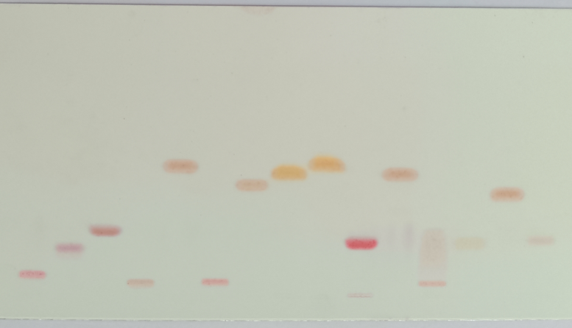
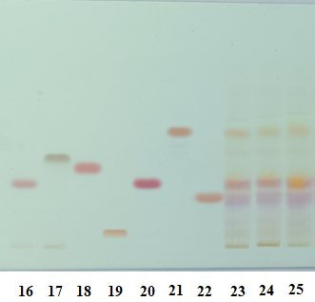
1
2
3
4
5
6
7
8
9
10
11
12
13
14
15
Figure S5. Amino acid profiling of rice on HPTLC plates (Silica gel 60 F254 Merck). Track 1: L-Arginine monohydrochloride, Track 2: DL-Aspartic Acid, Track 3: L-Glutamic Acid, Track 4: L-Histidine monohydrochloride, Track 5: L-Leucine, Track 6: L-Lysine monohydrochloride, Track 7: DL-Methionine, Track 8: L-Tyrosine, Track 9: DL-Phenylalanine, Track 10: DL-Serine, Track 11: DL-Isoleucine, Track 12: L-Cysteine monohydrochloride, Track 13: L-Proline, Track 14: DL-Valine, Track 15: L-Hydroxyproline, Track 16: DL-Threonine, Track 17: 3-(3,4-Dihydroxyphenyl)-DL-alanine [DL-DOPA], Track 18: DL-2-Amino-n-butyric acid, Track 19: L-Ornithine monohydrochloride, Track 20: DL-Alanine, Track 21: L-Tryptophan, Track 22: Glycine, Track 23: Group I, Track 24: Group II and Track 25: Group III.

Slide 6
Putriscine (R_{t}: 2.4 min)
Spermidine (R_{t}: 3.4 min)
Figure S6. HPLC chromatograms of spermidine and putrescine.

