Slide 1
Supplementary Material
Mitochondrial and cardiovascular responses to aerobic exercise training with legs above the heart in healthy young adults: A randomized parallel arm trial
Nicholas Preobrazenski, Stuart P.S Mladen, Ejaz Causer, Eveline Menezes, Hashim Islam, Patrick J. Drouin, Michael E. Tschakovsky, Brendon J. Gurd
Faculty of Medicine, University of Ottawa, Ottawa, Ontario, Canada School of Kinesiology and Health Studies, Queen’s University, Kingston, Ontario, Canada

Slide 2
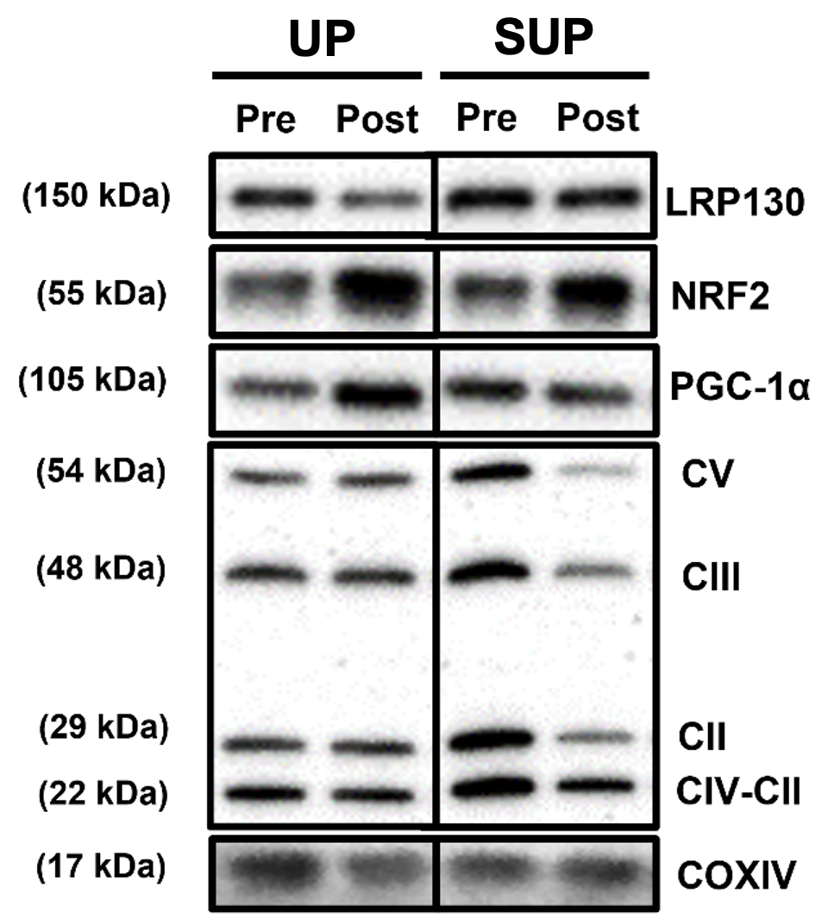
Supplemental Figure 1. Representative western blots from a participant completing upright (UP; n = 10; closed bars) and supine (SUP; n = 9; open bars) aerobic exercise training.

Slide 3
Supplemental Table 1. Peak cardiovascular responses to upright or supine aerobic training.
 | PRE |  | POST | UP-trained |  | SUP-trained |  | Time | Group | T x G
 |  |  |  | PRE | POST | PRE | POST
Upright ramp test | (n = 13; 9F) | (n = 14; 9F) |  | (n = 8; 5F) | (n = 9; 6F) | (n = 7; 5F) | (n = 6; 4F)
CO (L/min) | 20.5 ± 4.9 |  | 21.0 ± 5.2 | 21.8 ± 5.7 | 20.8 ± 5.6 | 19.0 ± 2.9 | 20.7 ± 3.4 | 0.06 | 0.65 | 0.06
SV (mL) | 119.7 ± 25.9 |  | 123.0 ± 31.7 | 127.3 ± 29.2 | 122.0 ± 19.8 | 111.1 ± 17.9 | 121.2 ± 19.8 | 0.16 | 0.63 | 0.21
HR (bpm) | 183.4 ± 11.4 |  | 182.6 ± 12.1 | 181.7 ± 13.3 | 183.5 ± 14.1 | 185.4 ± 8.4 | 181.2 ± 4.2 | 0.69 | 0.91 | 0.75
 | (n = 12; 8F) |  | (n = 14; 9F) | (n = 7; 5F) | (n = 8; 5F) | (n = 5; 3F) | (n = 6; 4F)
Oxy[haem] (% max) | 37.5 ± 26.4 |  | 22.7 ± 20.1 | 37.2 ± 27.2 | 25.8 ± 23.5 | 37.9 ± 25.4 | 18.5 ± 10.7 | 0.04 | 0.81 | 0.48
Deoxy[haem] (% max) | 51.3 ± 17.5 |  | 50.6 ± 15.7 | 51.1 ± 17.1 | 49.3 ± 13.0 | 51.6 ± 18.1 | 52.4 ± 17.4 | 0.86 | 0.82 | 0.84
Supine ramp test | (n = 13; 9F) | (n = 14; 9F) |  | (n = 7; 5F) | (n = 8; 5F) | (n = 8; 6F) | (n = 6; 4F)
CO (L/min) | 19.5 ± 4.6 |  | 20.7 ± 5.0 | 20.7 ±6.2 | 19.3 ± 4.8 | 18.5 ± 1.7 | 22.6 ± 4.0 | 0.41 | 0.91 | 0.04
SV (mL) | 121.6 ± 26.5 |  | 128.1 ± 29.1 | 125.7 ± 3.2 | 122.7 ± 30.9 | 118.0 ± 14.2 | 135.4 ± 21.7 | 0.56 | 1.00 | 0.16
HR (bpm) | 170.2 ± 17.1* |  | 170.0 ± 16.3 | 174.2 ± 15.0 | 167.4 ± 20.0 | 166.7 ± 18.0 | 173.3 ± 4.3 | 0.98 | 0.95 | 0.07
 | (n = 12; 8F) |  | (n = 14; 9F) | (n = 8; 5F) | (n = 8; 5F) | (n = 6; 4F) | (n = 6; 4F)
Oxy[haem] (% max) | 33.8 ± 25.1 |  | 10.8 ± 6.4 | 45.5 ± 25.6 | 9.6 ± 6.1‡ | 18.3 ± 13.0† | 12.4 ± 5.9 | <0.01 | 0.07 | 0.03
Deoxy[haem] (% max) | 65.8 ± 20.0 |  | 55.0 ± 18.6 | 67.4 ± 16.6 | 50.0 ± 18.0 | 63.8 ± 23.7 | 60.3 ± 16.5 | 0.15 | 0.75 | 0.34
* Significant between-test difference at PRE. ‡ Significant within-group difference between PRE and POST. † Significant between-group difference at PRE. Values are means ± standard deviation. Due to data missing at random, mixed effects models were used to maximize statistical power. PRE and POST n values indicated group numbers following listwise deletion. Female (F) participants for each timepoint are reported alongside group numbers. CO, cardiac output; HR, heart rate; PRE, pre-training; SV, stroke volume; T x G, time by group interaction effect

Slide 4
Supplemental Table 2. Pre- and post-training ramp test peak cardiovascular responses (Total: N = 17; UP: n = 9; SUP: n = 8).
 | PRE | POST |  | UP-trained (n = 9) |  |  |  | SUP-trained (n = 8)
 |  |  |  | PRE | POST | Cohen’s d_{s} (p-value) | 95% CI | PRE | POST | Cohen’s d_{s} (p-value) | 95% CI
Upright ramp test | (n = 13; 9F) | (n = 14; 9F) | (n = 8; 5F) |  | (n = 9; 6F) |  |  | (n = 7; 5F) | (n = 6; 4F)
MAP (mmHg) | 107.1 ± 21.1 | 110.7 ± 20.2 |  | 109.6 ± 20.5 | 111.7 ± 16.5 | 0.11 (0.81) | [-1.41, 1.63] | 102.5 ± 19.5 | 109.5 ± 24.9 | 0.32 (0.58) | [-1.46, 2.10]
SBP (mmHg) | 186.8 ± 18.5 | 191. 3 ± 30.6 |  | 184.3 ± 13.8 | 186.4 ± 24.2 | 0.11 (0.83) | [-1.41, 1.63] | 188.6 ± 22.1 | 195.8 ± 38.5 | 0.23 (0.68) | [-1.55, 2.01]
DBP (mmHg) | 78.5 ± 18.9 | 81.9 ± 19.5 |  | 80.9 ± 16.6 | 82.7 ± 15.6 | 0.11 (0.82) | [-1.41, 1.63] | 76.4 ± 19.5 | 80.9 ± 24.4 | 0.20 (0.71) | [-1.58, 1.99]
TPC (L/min/mmHg) | 0.203 ± 0.061 | 0.208 ± 0.059 |  | 0.216 ± 0.08 | 0.199 ± 0.060 | -0.23 (0.64) | [-1.75, 1.29] | 0.206 ± 0.057 | 0.214 ± 0.060 | 0.14 (0.80) | [-1.64, 1.92]
Supine ramp test | (n = 13; 9F) | (n = 14; 9F) |  | (n = 7; 5F) | (n = 8; 5F) |  |  | (n = 8; 6F) | (n = 6; 4F)
MAP (mmHg) | 98.8 ± 21.6 | 105.4 ± 14.0 |  | 105.9 ± 22.8 | 106.0 ± 16.0 | 0.0058 (0.99) | [-1.63, 1.64] | 96.1 ± 18.7 | 104.5 ± 12.4 | 0.52 (0.35) | [-1.20, 2.23]
SBP (mmHg) | 175.4 ± 25.0 | 181.5 ± 22.9 |  | 170.2 ± 19.8 | 175.2 ± 16.4 | 0.28 (0.60) | [-1.36, 1.91] | 180.2 ± 26.2 | 190.0 ± 29.0 | 0.36 (0.51) | [-1.36, 2.07]
DBP (mmHg) | 71.7 ± 19.8 | 77.4 ± 13.2 |  | 76.6 ± 22.4 | 78.6 ± 14.3 | 0.11 (0.84) | [-1.53, 1.74] | 71.8 ± 17.9 | 75.8 ± 12.6 | 0.25 (0.65) | [-1.46, 1.97]
TPC (L/min/mmHg) | 0.223 ± 0.044 | 0.208 ± 0.062 |  | 0.207 ± 0.060 | 0.194 ± 0.062 | -0.22 (0.68) | [-1.85, 1.42] | 0.214 ± 0.053 | 0.228 ± 0.062 | 0.25 (0.65) | [-1.46, 1.97]
For the UP ramp test, Cohen’s d_{s} effect sizes were calculated as POST – PRE for independent groups with the following degrees of freedom (df): 15 df for UP-trained; 11 df for SUP-trained. For the SUP ramp test, Cohen’s ds effect sizes were calculated as POST – PRE for independent groups with the following degrees of freedom (df): 13 df for UP-trained; 12 df for SUP-trained. Data from 2 participants, and specific trials from 6 participants were not included due to measurement error. Values are means ± standard deviation. DBP, diastolic blood pressure; MAP, mean arterial pressure; POST, post-training; PRE, pre-training; SBP, systolic blood pressure; SUP, supine; TPC, total peripheral conductance; UP, upright.

Slide 5
WESTERN BLOTS

Slide 6
oxphos
1 PRE
1 POST
2 PRE
2 POST
3 PRE
3 POST
4 PRE
4 POST
12% gel
Loaded 8 ug protein
Ran 1 hr @ 150V
Transferred 1 hr @100V
Blocked in 5% BSA for 1 hr
1˚mouse (ab110411, 1:1000) in 5% BSA 0.1% TBST overnight @4˚C
2˚ anti-mouse (1:20000) in TBST 1 hr @ room temp
Exposed 5 min
September 4 2020
3 POST
ab110411
1 PRE
1 POST
2 PRE
2 POST
3 PRE
4 PRE
4 POST
Oxphos [AMIDO BL]
September 4 2020

Slide 7
oxphos
5 PRE
5 POST
6 PRE
6 POST
7 PRE
7 POST
8 PRE
8 POST
10 PRE
10 POST
11 PRE
11 POST
12 PRE
12 POST
12% gel
Loaded 8 ug protein
Ran 1 hr @ 150V
Transferred 1 hr @100V
Blocked in 5% BSA for 1 hr
1˚mouse (ab110411, 1:1000) in 5% BSA 0.1% TBST overnight @4˚C
2˚ anti-mouse (1:20000) in TBST 1 hr @ room temp
Exposed 5 min
September 9 2020
13 PRE
13 POST
14 PRE
14 POST
15 PRE
15 POST
16 PRE
16 POST
17 PRE
17 POST
18 PRE
18 POST
19 PRE
19 POST
September 10 2020

Slide 8
Oxphos [AMIDO BL]
5 PRE
5 POST
6 PRE
6 POST
7 PRE
7 POST
8 PRE
8 POST
10 PRE
10 POST
11 PRE
11 POST
12 PRE
12 POST
12% gel
Loaded 8 ug protein
Ran 1 hr @ 150V
Transferred 1 hr @100V
Blocked in 5% BSA for 1 hr
1˚mouse (ab110411, 1:1000) in 5% BSA 0.1% TBST overnight @4˚C
2˚ anti-mouse (1:20000) in TBST 1 hr @ room temp
Exposed 5 min
September 9 2020
13 PRE
13 POST
14 PRE
14 POST
15 PRE
15 POST
16 PRE
16 POST
17 PRE
17 POST
18 PRE
18 POST
19 PRE
19 POST
September 10 2020

Slide 9
oxphos
20 PRE
20 POST
6 PRE
6 POST
10 PRE
10 POST
11 PRE
11 POST
12% gel
Loaded 8 ug protein
Ran 1 hr @ 150V
Transferred 1 hr @100V
Blocked in 5% BSA for 1 hr
1˚mouse (ab110411, 1:1000) in 5% BSA 0.1% TBST overnight @4˚C
2˚ anti-mouse (1:20000) in TBST 1 hr @ room temp
Exposed 5 min
September 10 2020
20 PRE
20 POST
6 PRE
6 POST
10 PRE
10 POST
11 PRE
11 POST
Oxphos [AMIDO BL]

Slide 10
LRP130
1 PRE
1 POST
2 PRE
2 POST
3 PRE
3 POST
4 PRE
4 POST
5 PRE
5 POST
6 PRE
6 POST
7 PRE
7 POST
8% gel
Loaded 25 ug protein
Ran 1 hr @ 150V
Transferred 1 hr @100V (SDS used in buffer)
Blocked in 5% BSA for 1 hr
1˚rabbit (CS#3661, 1:1000) in 5% BSA 0.1% TBST overnight @4˚C
2˚ goat anti-rabbit (1:1000) in TBST 1 hr @ room temp
Exposed 5 min
8 PRE
8 POST
10 PRE
10 POST
11 PRE
11 POST
12 PRE
12 POST
13 PRE
13 POST
14 PRE
14 POST
15 PRE
15 POST
September 11 2020
16 PRE
16 POST
17 PRE
17 POST
18 PRE
18 POST
19 PRE
19 POST
20 PRE
20 POST
September 11 2020

Slide 11
LRP130 [AMIDO BL]
1 PRE
1 POST
2 PRE
2 POST
3 PRE
3 POST
4 PRE
4 POST
5 PRE
5 POST
6 PRE
6 POST
7 PRE
7 POST
8 PRE
8 POST
10 PRE
10 POST
11 PRE
11 POST
12 PRE
12 POST
13 PRE
13 POST
14 PRE
14 POST
15 PRE
15 POST
8% gel
Loaded 25 ug protein
Ran 1 hr @ 150V
Transferred 1 hr @100V (SDS used in buffer)
Blocked in 5% BSA for 1 hr
1˚rabbit (CS#3661, 1:1000) in 5% BSA 0.1% TBST overnight @4˚C
2˚ goat anti-rabbit (1:1000) in TBST 1 hr @ room temp
Exposed 5 min
September 11 2020
16 PRE
16 POST
17 PRE
17 POST
18 PRE
18 POST
19 PRE
19 POST
20 PRE
20 POST
September 11 2020

Slide 12
COXIV
17 POST
18 PRE
18 POST
20 POST
16 PRE
16 POST
17 PRE
19 PRE
19 POST
20 PRE
1 PRE
1 POST
2 PRE
3 POST
4 PRE
6 PRE
6 POST
7 PRE
7 POST
2 POST
3 PRE
4 POST
5 PRE
5 POST
8 PRE
10 PRE
10 POST
September 23 2020
8 POST
11 PRE
12 POST
11 POST
12 PRE
13 PRE
13 POST
14 PRE
14 POST
15 PRE
15 POST
September 23 2020
[AMIDO BL]
September 23 2020
15% gel
Loaded 8 ug protein
Ran 1 hr @ 150V
Transferred 1 hr @100V
Blocked in 5% BSA for 1 hr
1˚mouse (ab110411, 1:1000) in 5% BSA 0.1% TBST overnight @4˚C
2˚ anti-mouse (1:20000) in TBST 1 hr @ room temp
Exposed 5 min
[AMIDO BL]
September 23 2020

Slide 13
NRF2
55 KDA
1 PRE
1 POST
2 PRE
2 POST
3 PRE
3 POST
4 PRE
4 POST
5 PRE
5 POST
6 PRE
6 POST
7 PRE
7 POST
10% gel
Loaded 8 ug protein
Ran 1 hr @ 150V
Transferred 1 hr @100V
Blocked in 5% BSA for 1.5 hr
1˚rabbit (csD1Z9C-XP, 1:1000) in 5% BSA 0.1% TBST overnight @4˚C
2˚ anti-rabbit (1:10000) in TBST 1 hr @ room temp
Exposed 5 min
10 PRE
11 PRE
11 POST
12 POST
13 PRE
13 POST
14 PRE
14 POST
15 PRE
15 POST
8 PRE
8 POST
10 POST
12 PRE
16 PRE
16 POST
17 PRE
17 PRE
17 POST
18 PRE
18 POST
19 PRE
19 POST
20 PRE
20 POST
***3x10min washes after the secondary
September 24 2020
[AMIDO BL]
September 24 2020

Slide 14
PGC1a
105 KDA
4 POST
5 PRE
5 POST
6 PRE
6 POST
7 PRE
7 POST
1 PRE
1 POST
2 PRE
2 POST
3 PRE
3 POST
4 PRE
10% gel
Loaded 8 ug protein
Ran 1 hr @ 150V
Transferred 1 hr @100V (SDS)
Blocked in 5% BSA for 1 hr
1˚rabbit (ab3242, 1:1000) in 5% BSA 0.1% TBST overnight @4˚C
2˚ anti-rabbit (1:10000) in TBST 1 hr @ room temp
Exposed 5 min
8 POST
10 PRE
10 POST
11 PRE
11 POST
12 PRE
12 POST
13 PRE
13 POST
14 PRE
14 POST
15 PRE
15 POST
8 PRE
17 PRE
17 PRE
17 POST
18 PRE
18 POST
19 PRE
19 POST
20 PRE
20 POST
16 PRE
16 POST
September 24 2020
[AMIDO BL]
September 24 2020

