Slide 1
FITC
Merged
FITC
Merged
FITC
Merged
FITC
Merged
MDA-MB-231 C
Ind^{(A)}
Inh^{(A)}
Ind^{(B)}
Inh^{(B)}
Cisplatin
Ind^{(A) + C}
Inh^{(A) + C}
T-47D C
Ind^{(A)}
Inh^{(A)}
Ind^{(B)}
Inh^{(B)}
Cisplatin
Ind^{(A) + C}
Inh^{(A) + C}
Supplementary figure 1: Microphotographs showing the expression of pMLKL in MDA-MB-231 and T-47D after necroptosis modulation with aspirin and BV-6 alone as well as along with cisplatin. Primary anti MLKL and FITC conjugated secondary antibodies have been used to study the expression. Nuclei have been counterstained with DAPI. Confocal microscopy; 60X. Red boxes show zoomed images for better visualization of staining intensity

Slide 2
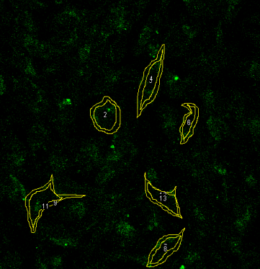
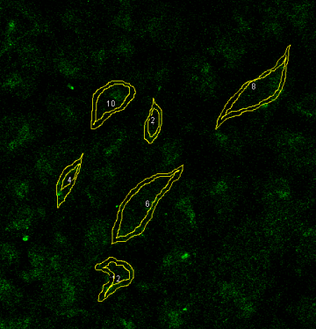
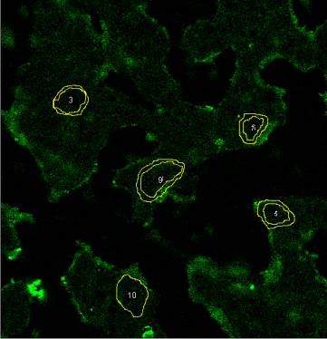
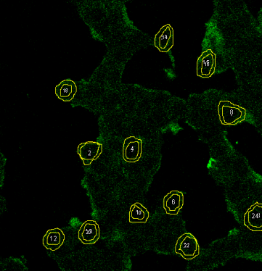
(A 1)
(A 2)
(A 3)
(A 4)
Supplementary figure 2: Confocal microscopy pictures showing the measurement of pMLKL localization towards plasma membrane after necroptosis modulation with or without chemotherapy in MDA-MB-231 (A1-8) and T-47D cells (B1-8).
MDA-MB-231 Control
Ind^{(A)}
Inh^{(A)}
Ind^{(B)}
(A 5)
(A 6)
(A 7)
(A 8)
Inh^{(B)}
Cisplatin
Ind^{(A) + C}
Inh^{(A) + C}
(B 1)
(B 2)
(B 3)
(B 4)
T-47D Control
Ind^{(A)}
Inh^{(A)}
Ind^{(B)}
(B 5)
(B 6)
(B 7)
(B 8)
Inh^{(B)}
Cisplatin
Ind^{(A) + C}
Inh^{(A) + C}

Slide 3
(A)
(B)
Supplementary figure 3: Graph A, B showing the results of MTT assay and Annexin-V/PI assay after treatment with drugs alone. Graph
C showing the results of Annexin-V/PI assay after necroptosis modulation with higher dose of Aspirin & Aspirin + BV-6 along with chemotherapy combinations in T-47D cell line respectively.
(C)
(D)

