Slide 1
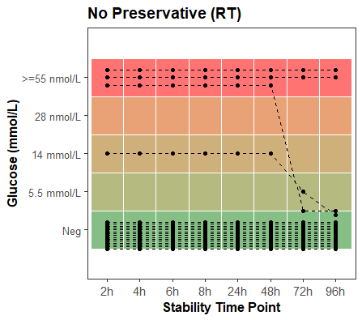
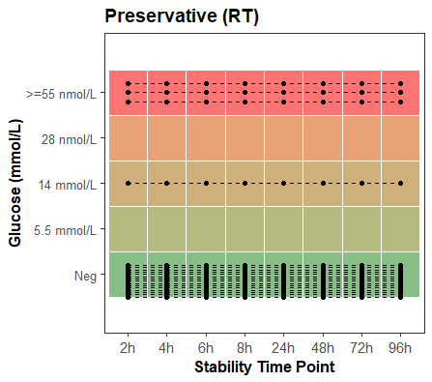
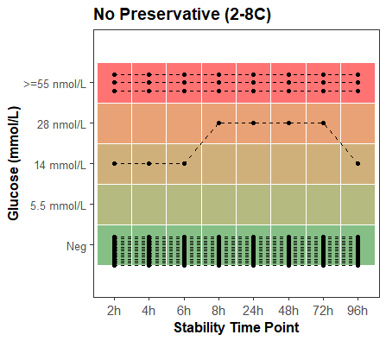
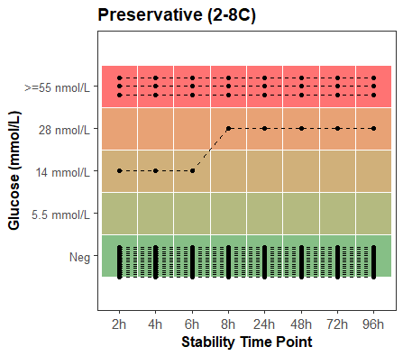
A. | B.
C. | D.
Supplemental Figure 1. Glucose urinalysis stability for four conditions: A) no preservative at room temperature, B) preservative tube at room temperature, C) no preservative tube at 2-8°C, D) preservative tube at 2-8°C. Spacing of points within a qualitative result block was randomized.

Slide 2
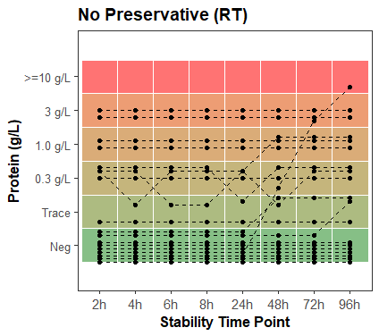
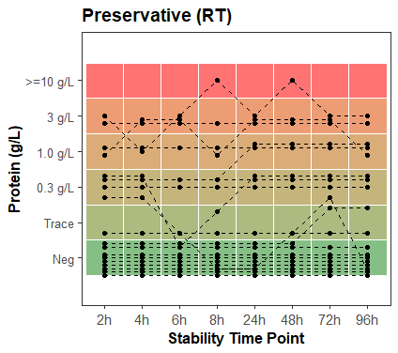
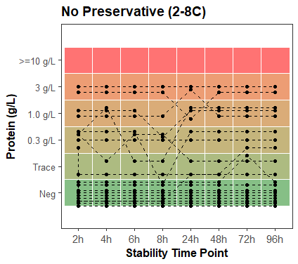
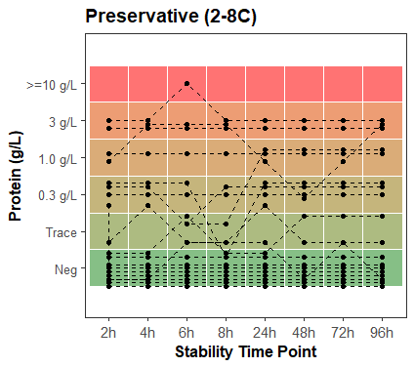
Supplemental Figure 2. Protein urinalysis stability for four conditions: A) no preservative at room temperature, B) preservative tube at room temperature, C) no preservative tube at 2-8°C, D) preservative tube at 2-8°C. Spacing of points within a qualitative result block was randomized.

Slide 3
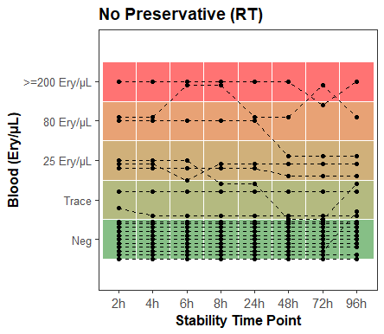
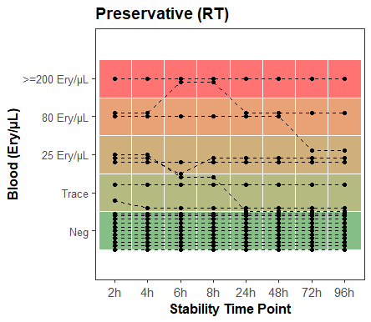
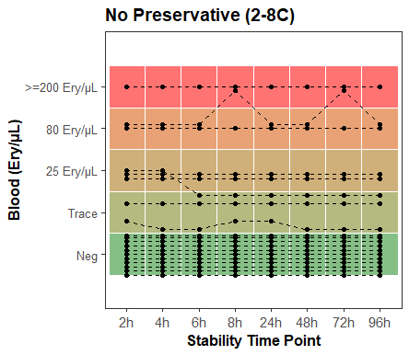
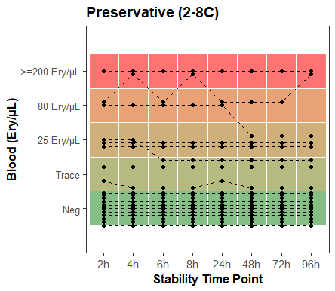
A. | B.
C. | D.
Supplemental Figure 3. Blood urinalysis stability for four conditions: A) no preservative at room temperature, B) preservative tube at room temperature, C) no preservative tube at 2-8°C, D) preservative tube at 2-8°C. Spacing of points within a qualitative result block was randomized.

Slide 4
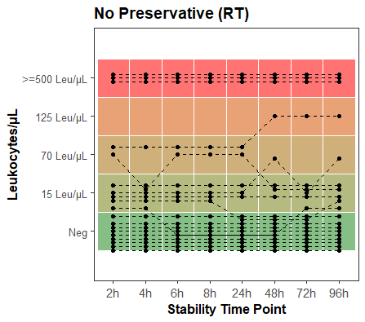
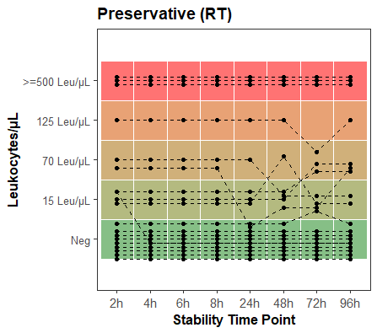
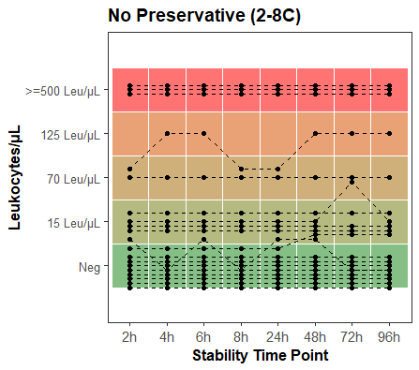
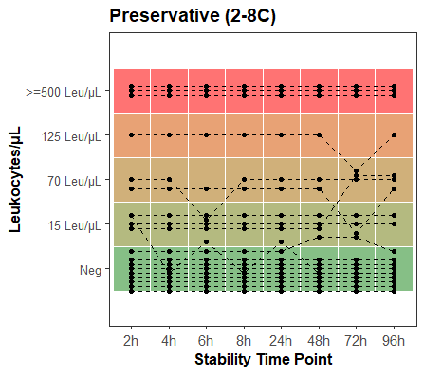
A. | B.
C. | D.
Supplemental Figure 4. Leukocytes urinalysis stability for four conditions: A) no preservative at room temperature, B) preservative tube at room temperature, C) no preservative tube at 2-8°C, D) preservative tube at 2-8°C. Spacing of points within a qualitative result block was randomized.

Slide 5
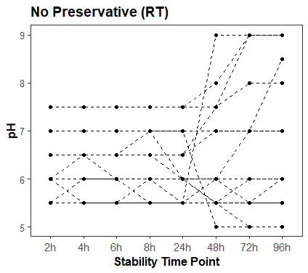
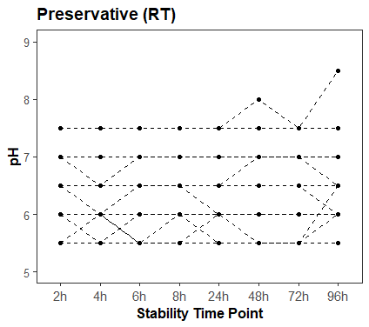
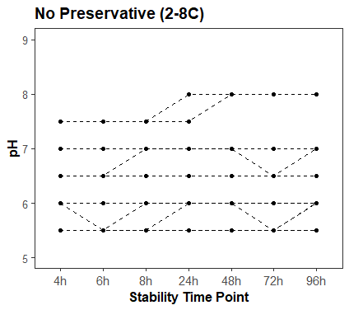
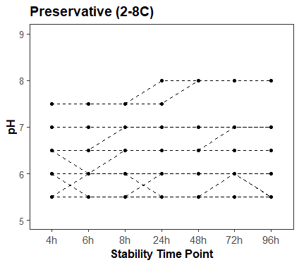
A. | B.
C. | D.
Supplemental Figure 5. pH urinalysis stability for four conditions: A) no preservative at room temperature, B) preservative tube at room temperature, C) no preservative tube at 2-8°C, D) preservative tube at 2-8°C. Spacing of points within a qualitative result block was randomized.

Slide 6
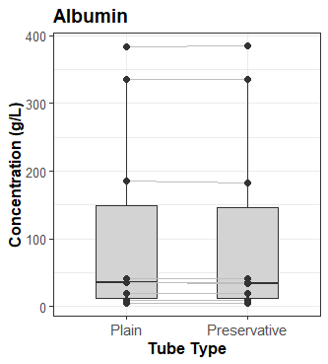
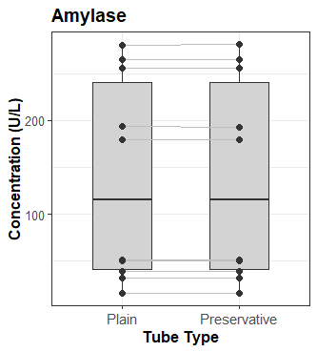
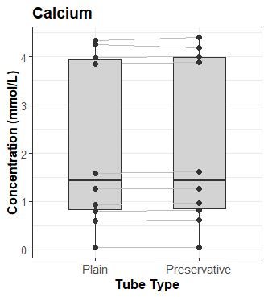
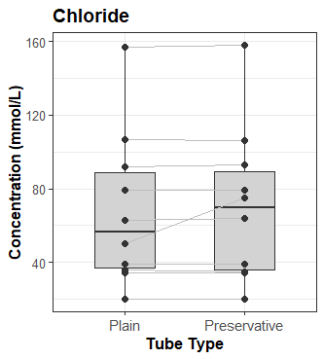
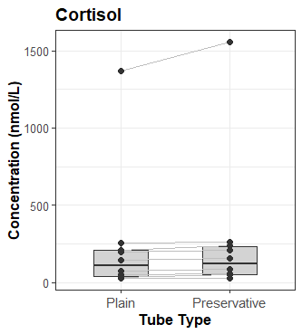
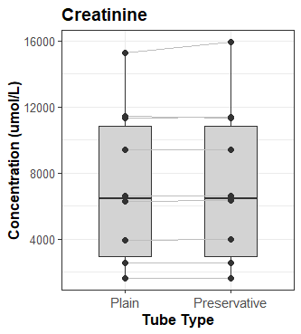
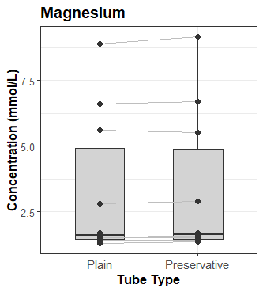
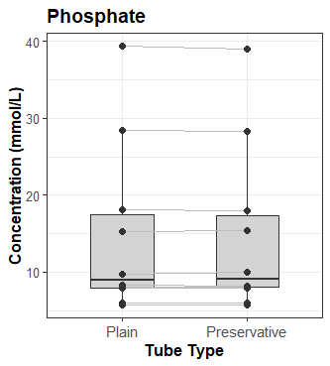
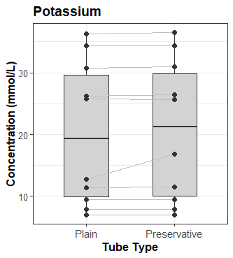
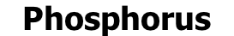
A. | B. | C.
D. | E. | F.
G. | H. | I.
Supplemental Figure 6. Comparison of urine chemistry result values with and without preservative for A) albumin, B) amylase, C) calcium, D) chloride, E) cortisol, F) creatinine, G) magnesium, H) phosphate, I) potassium. Boxplots represent median and interquartile range and individual samples are connected by grey lines.

Slide 7
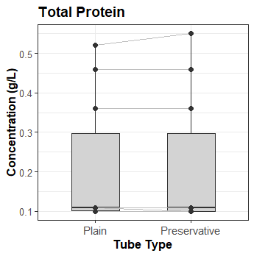
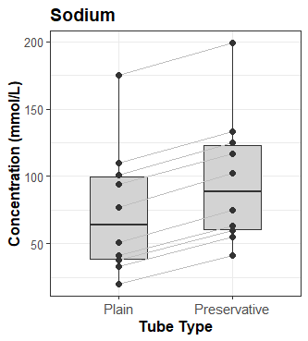
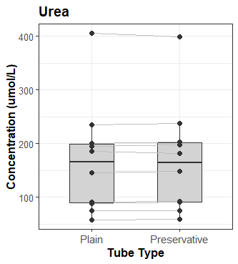
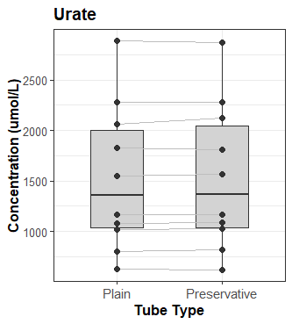
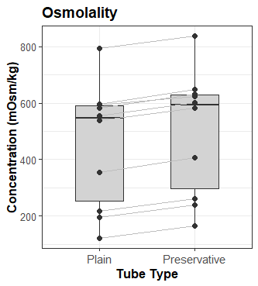
A. | B. |  | C.
D. |  | E.
Supplemental Figure 7. Comparison of urine chemistry result values with and without preservative for A) protein, B) sodium, C) urea, D) urate, E) osmolality. Boxplots represent median and interquartile range and individual samples are connected by grey lines.

