Slide 1
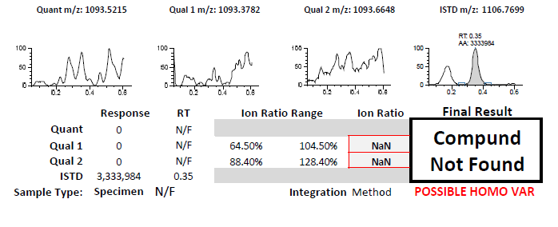
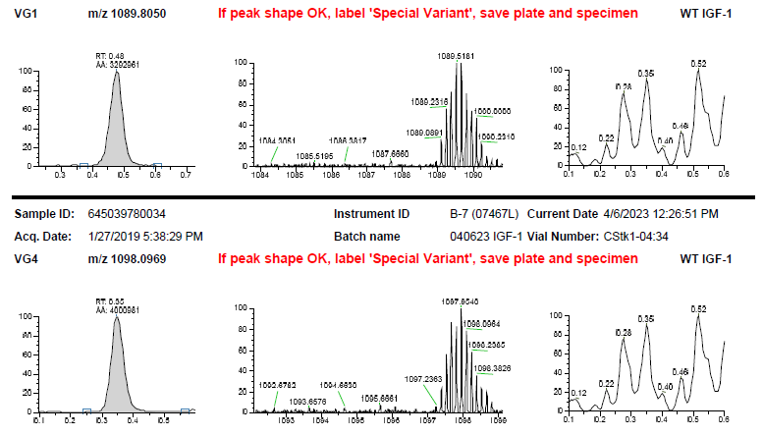
A
Double Heterozygous Patient Batch Report
WT absent
B
Double Heterozygous Patient Variant Report
WT absent
WT absent
Notes:
Supplementary Figure S1. An example of a double heterozygous patient. Batch Report (A) indicates the absence of the WT IGF-1 (and its confirming ions) and provides an alert message that the current patient may be homozygous variant. Variant Report (B) indicates the presence of two heterozygous IGF-1 variants in a single patient, one at VG1 and the other at VG4. Both reports are automatically generated for a CLS to review.

Slide 2
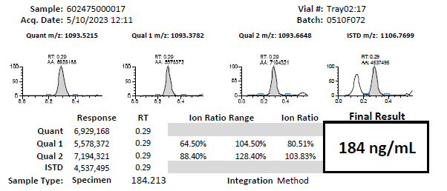
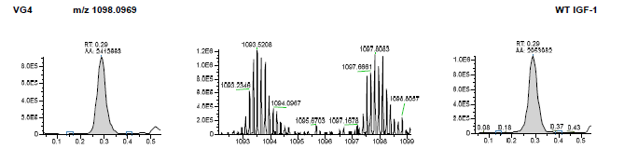
A
Typical Patient Batch Report
B
Typical Patient Variant Report
Notes:
Supplementary Figure S2. An example of a typical patient. Batch Report (A) indicates the presence of the WT IGF-1 (and its confirming ions) and provides a quantitative values for the analyte. Variant Report (B) indicates the presence of two peaks, one corresponding to a WT protein and the other to heterozygous IGF-1 variants at VG4. Both reports are automatically generated for a CLS to review.

Slide 3
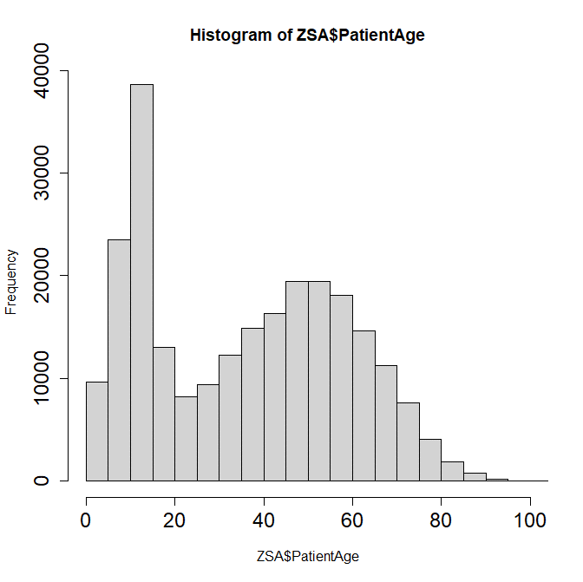
Overall tested population
Occurrence
Age
Notes:
Supplementary Figure S3. IGF-1 variants occurrences versus patient’s age for overall tested population (all patients submitted for the IGF-1 test).

Slide 4
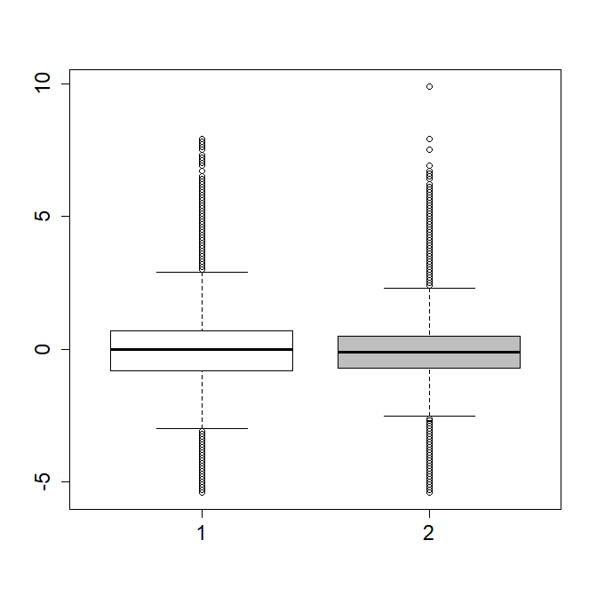
Z-score
M
n=119,640
F
n=119,990
Notes:
Supplementary Figure S4. Z-score comparison between females and males in the overall clinical population.

Slide 5
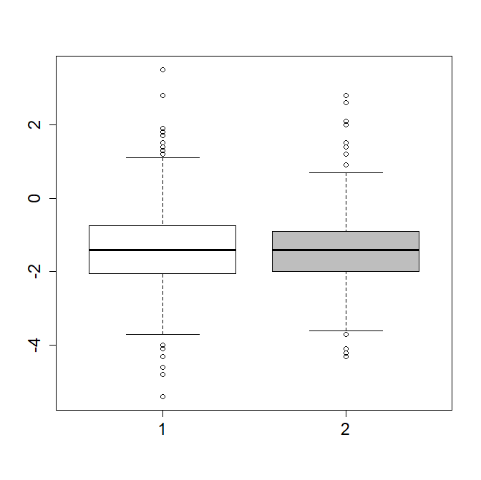
Z-score
M
n=535
F
n=551
Notes:
Supplementary Figure S5. Z-score comparison between females and males in the population with detected IGF-1 variants.

