Slide 1
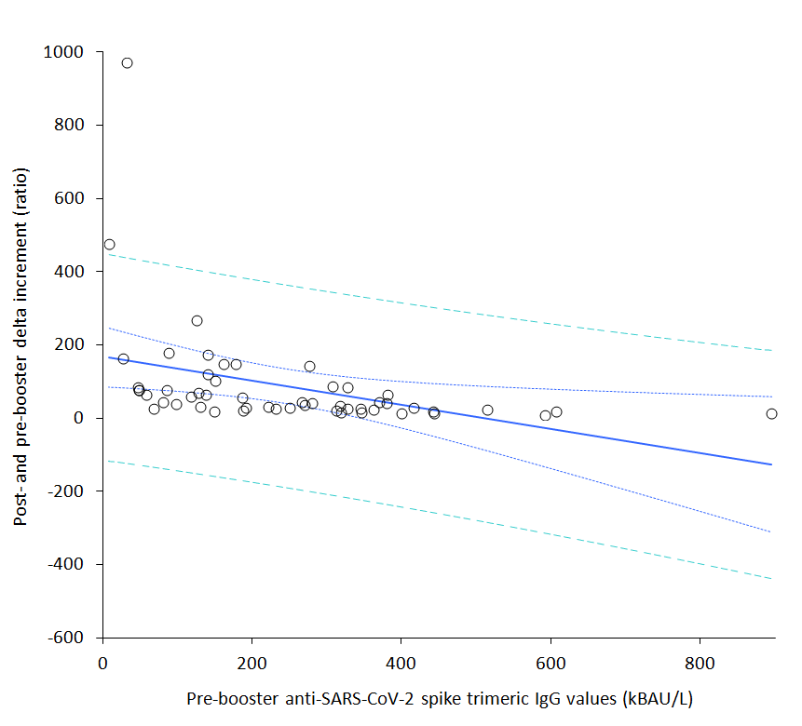

Slide 2
Supplementary Figure 1. Spearman’s correlation of anti-SARS-CoV-2 spike trimeric IgG values after and immediately before the booster vaccine dose (delta variation) with pre-booster levels.
SARS-CoV-2; severe acute respiratory syndrome coronavirus 2.

