Slide 1
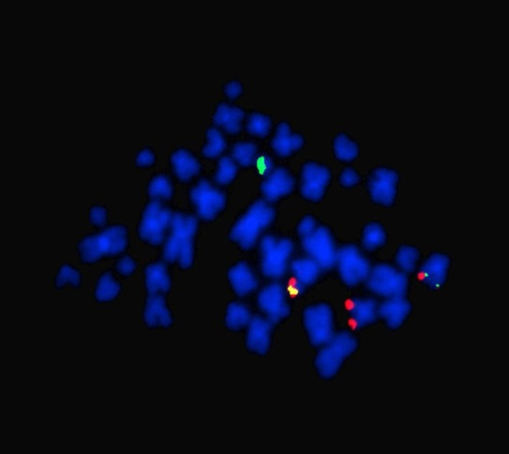
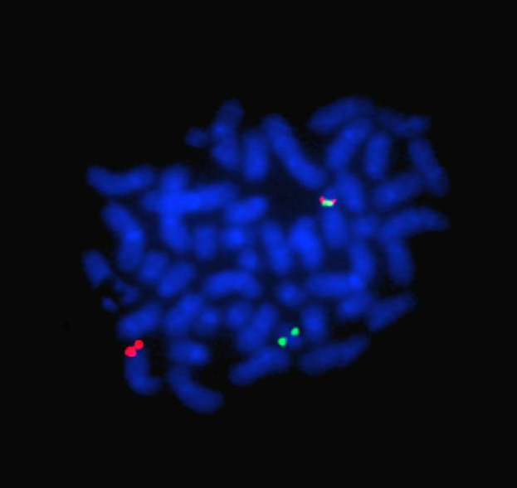
A
Case | Cytogenetics ISH
#1 | 46,XX,t(9;22)(q34;q11.2).ish t(9;22)(ABL1+,BCR+;BCR+,ABL1+)
#2 | 46,XX,t(9;22)(q34;q11.2).ish t(9;22)(ABL1+,BCR+;BCR+,ABL1+)
#3 | 46,XY,t(9;22)(q34;q11.2).ish t(9;22)(ABL1+,BCR+;BCR+,ABL1+)
#4 | 46,XY,t(9;22)(q34;q11.2).ish t(9;22)(ABL1+,BCR+;BCR+,ABL1+)
#5 | 46,XY,t(9;22)(q34;q11.2).ish t(9;22)(ABL1+,BCR+;BCR+,ABL1+)
#6 | 46,XY,t(9;22)(q34;q11.2).ish der(9)t(9;22)del(9)(q34q34)(ABL1-,BCR-),der(22)t(9;22)(BCR+,ABL1+)
#7 | 46,XX,t(9;22)(q34;q11.2).ish der(9)t(9;22)del(9)(q34q34)(ABL1-,BCR+),der(22)t(9;22)(BCR+,ABL1+)
B
C

Slide 2
Supplemental Figure 2. Cytogenetics and cyto-molecular analysis by FISH. (A) Description of the cytogenetic and FISH analysis by dual fusion-dual color probes. (B) Metaphase with a conventional t(9,22) detected using dual-fusion probes for BCR and ABL1. Fusion signals correspond to derivatives chromosomes 9 and 22, and red and green signals correspond to ABL1 and BCR on normal chromosomes 9 and 22, respectively. (C) It shows a t(9;22) associated with a deletion on der(9) encompassing both ABL1 and BCR locus (case #6).

